Slide 1



Ad-Hoc Insight
Consumer Goods
Presented By: Zaid Ansari

Slide 2

Table Of Content
1. Company Overview 2. Problem Statement 3. Dataset & Model 4. Ad-Hoc Requests , Output & Insights 5. Recommendations

Slide 3
Company Overview
AtliQ Hardware's (imaginary company) is one of the leading computer hardware producers in India and well expanded in other countries too.

Slide 4
Problem Statement
Management noticed a lack of insights for quick, smart data-informed decisions.
Decision made to expand the data analytics team with several junior data analysts.
Tony Sharma, the data analytics director, seeks candidates with strong tech and soft skills.
To evaluate these skills, Tony decided to conduct a SQL challenge.

Slide 5
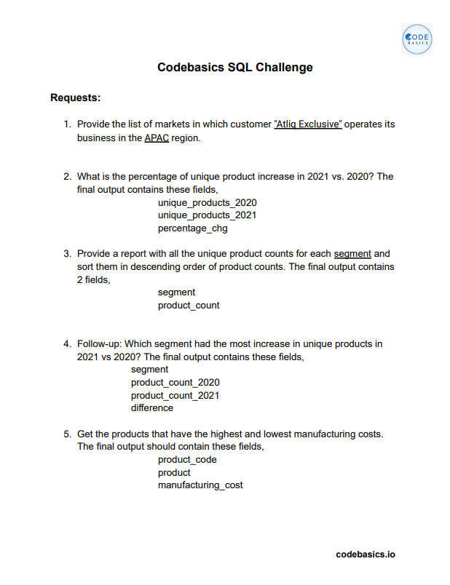
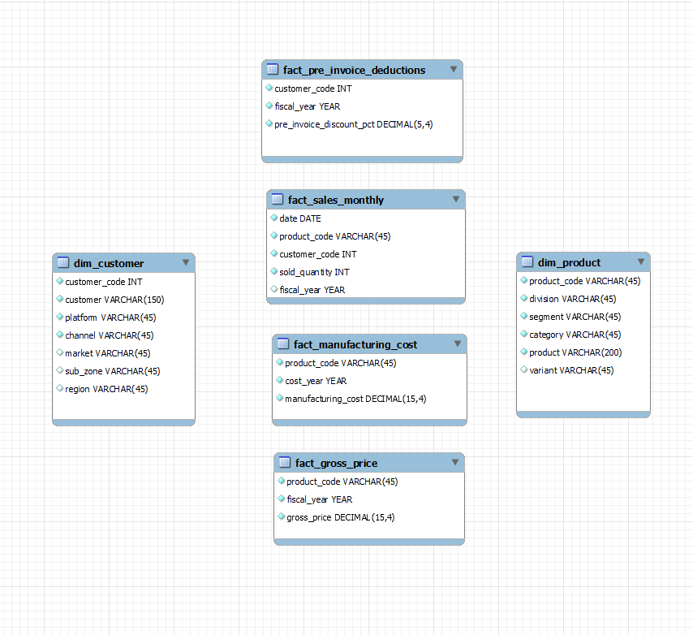
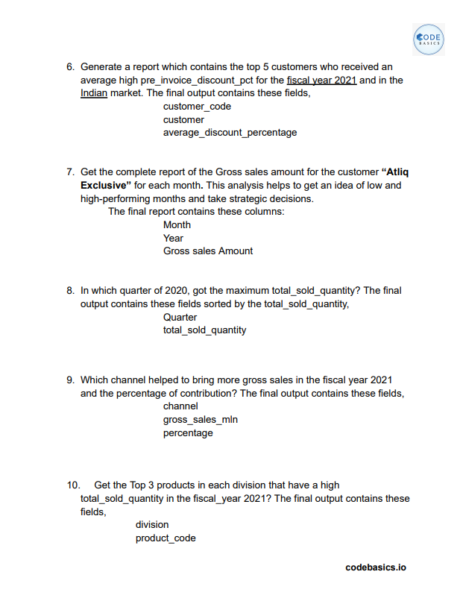
Dataset Used

Slide 6
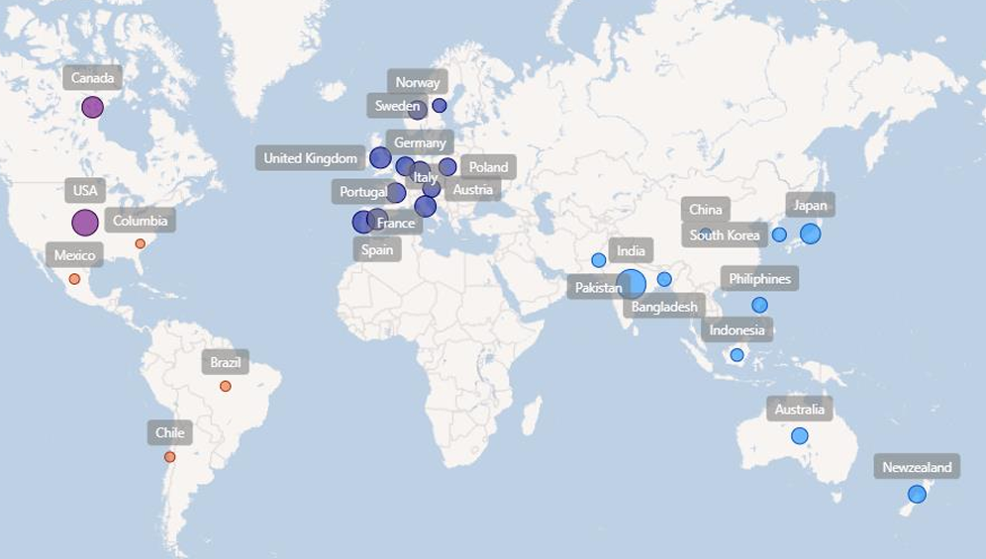
Markets Presence Of AtliQ

Slide 7
Ad-hoc Requests , Output Insights & Visuals

Slide 8
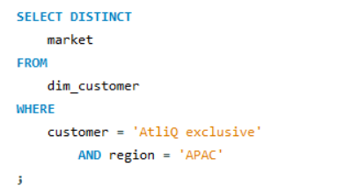
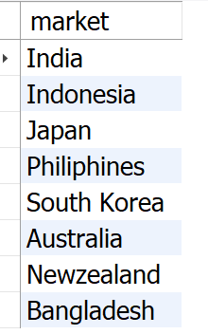
Request: 01
PROVIDE THE LIST OF MARKETS IN WHICH CUSTOMER "ATLIQ EXCLUSIVE" OPERATES ITS BUSINESS IN THE APAC REGION.

Slide 9
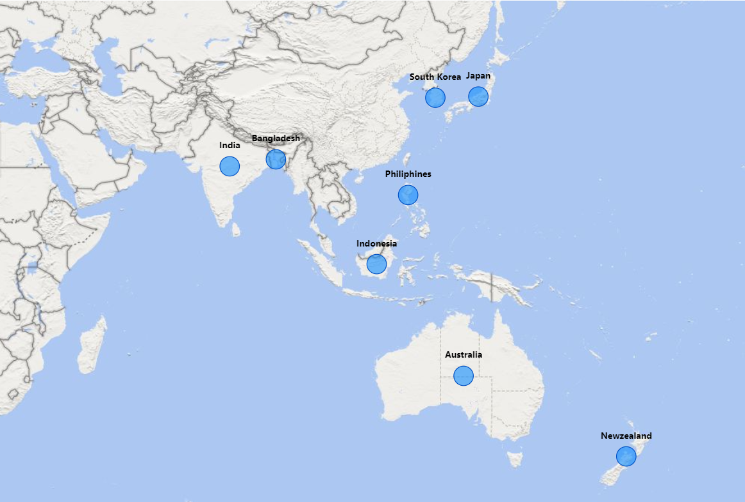
VISUAL REFFERENCE FOR REQUEST 01
INSIGHT:
AtliQ Exclusive operates in eight countries within the APAC region, demonstrating a significant regional market presence.

Slide 10
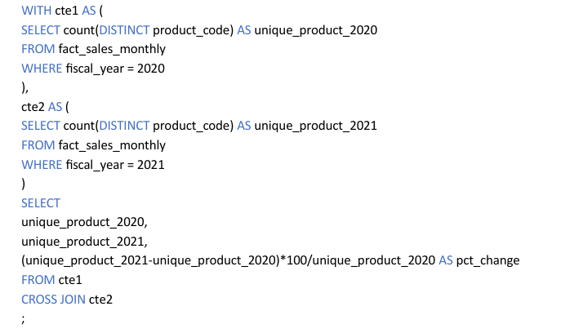
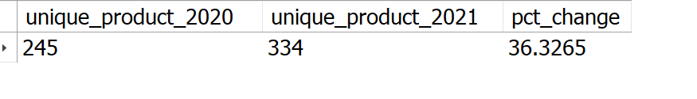
Request: 02
WHAT IS THE PERCENTAGE OF UNIQUE PRODUCT INCREASE IN 2021VS. 2020? THE FINAL OUTPUT CONTAINS THESE FIELDS, UNIQUE_PRODUCTS_2020 UNIQUE_PRODUCTS_2021 PERCENTAGE_CHG

Slide 11
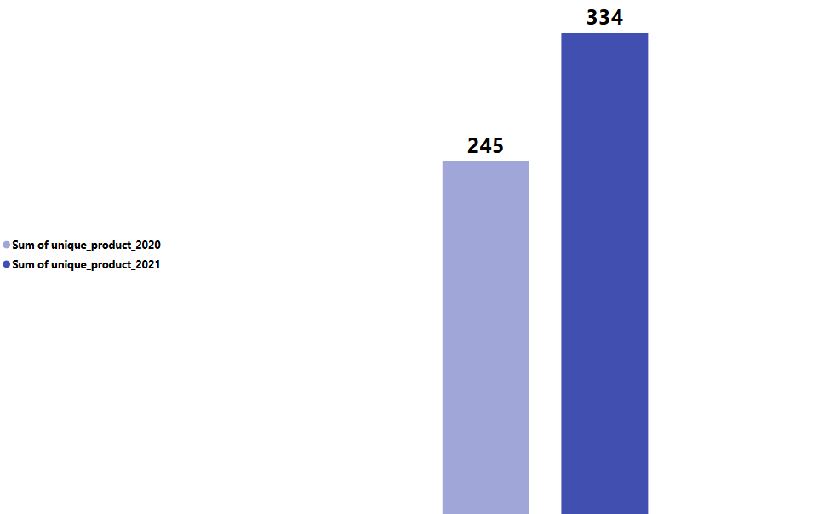
VISUAL REFFERENCE FOR REQUEST 02
36.33%
The number of unique products grew from 245 in 2020 to 334 in 2021, marking a 36.33% increase.
2. This significant increase highlights the company's commitment to innovation and meeting diverse customer needs.
INSIGHT:

Slide 12
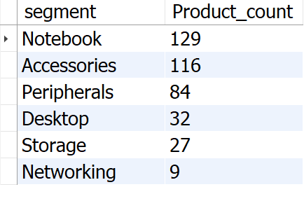
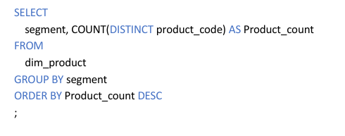
Request: 03
PROVIDE A REPORT WITH ALL THE UNIQUE PRODUCT COUNTS FOR EACH SEGMENT AND SORT THEM IN DESCENDING ORDER OF PRODUCT COUNTS.THE FINAL OUTPUT CONTAINS 2 FIELDS, SEGMENT PRODUCT_COUNT

Slide 13
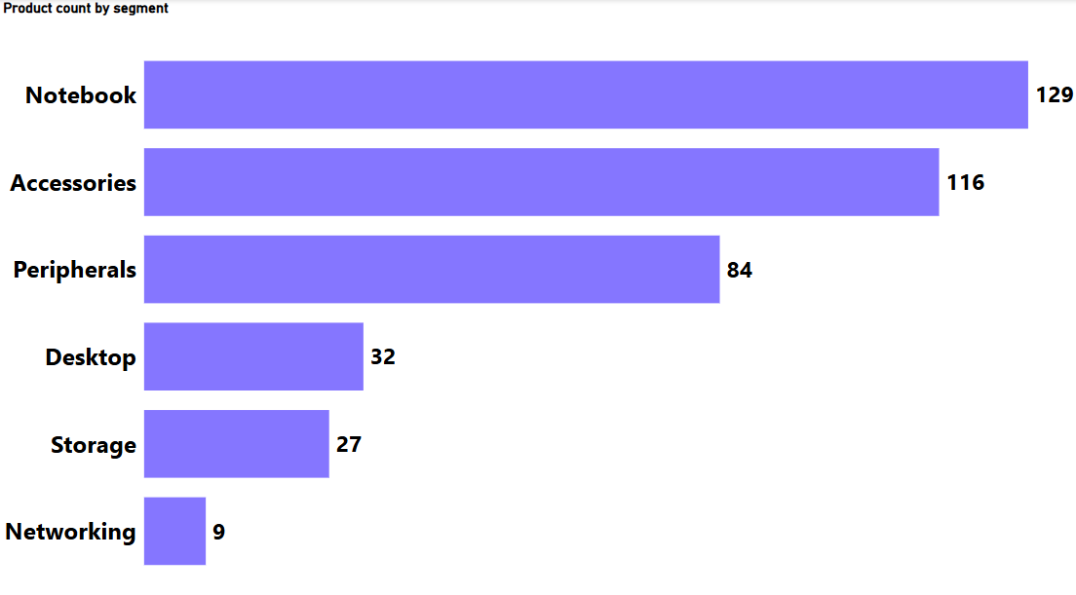
VISUAL REFFERENCE FOR REQUEST 03
AtliQ shines in Notebooks, Accessories, and Peripherals segment, accounting for a whopping 82.87% of product variety.
Desktops, Storage, and Networking currently hold a minor share (17.13%) of AtliQ product portfolio.
In Desktops, Storage, and Networking segment AtliQ should focus on products that align with current customer trends and industry demands.
INSIGHT:

Slide 14
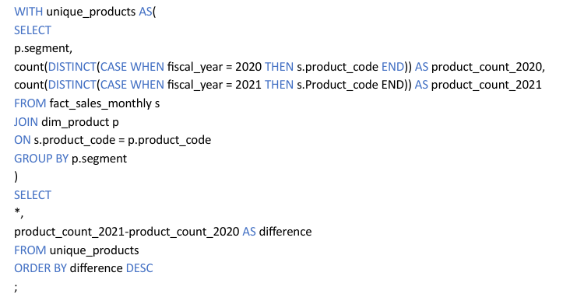
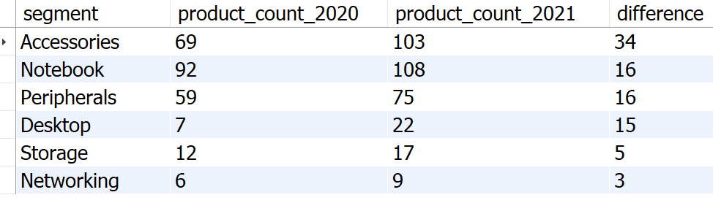
Request: 04
FOLLOW-UP: WHICH SEGMENT HAD THE MOST INCREASE IN UNIQUE PRODUCTS IN 2021 VS 2020? TTHE FINAL OUTPUT CONTAINS THESE FIELDS, SEGMENT PRODUCT_COUNT_2020 PRODUCT_COUNT_2021 DIFFERENCE

Slide 15
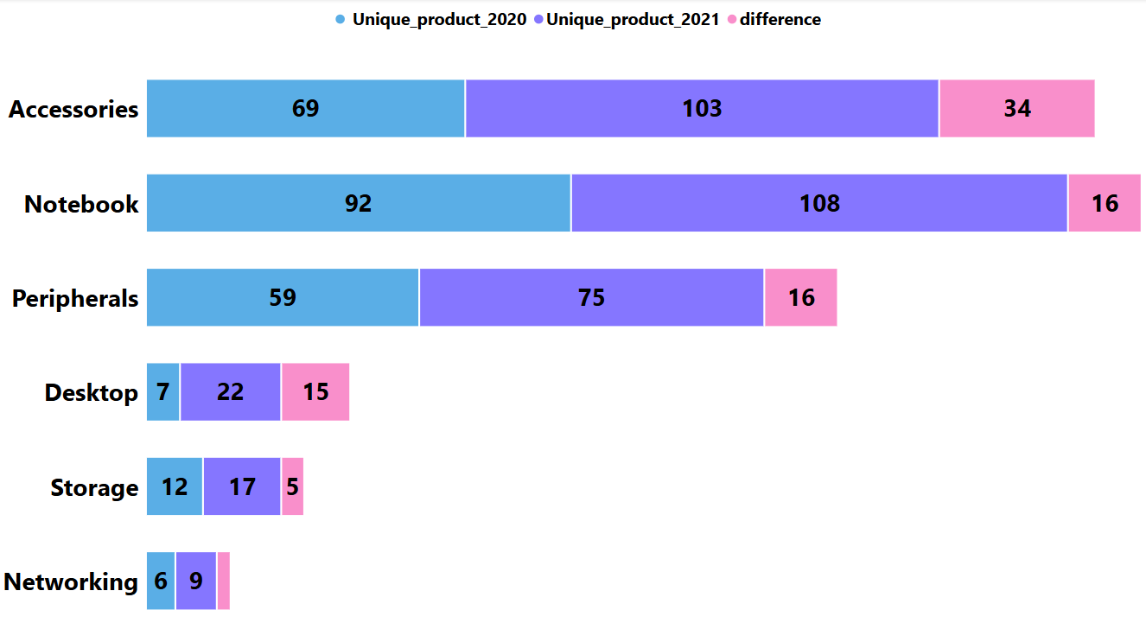
VISUAL REFFERENCE FOR REQUEST 04
1. Accessories have the most increased products from 2020 to 2021, with an increase of 34 new products.
2. Desktop products production increased drastically by approximately 214% from 2020 to 2021.
3. Storage and Networking segments are producing the least new products from 2020 to 2021.
INSIGHT:

Slide 16
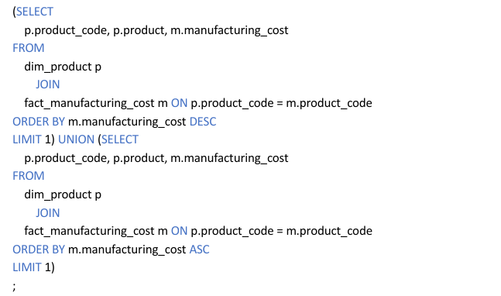
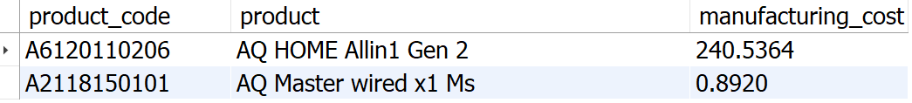
Request: 05
GET THE PRODUCTS THAT HAVE THE HIGHEST AND LOWEST MANUFACTURING COSTS. THE FINAL OUTPUT SHOULD CONTAIN THESE FIELDS, PRODUCT_CODE PRODUCT MANUFACTURING_COST

Slide 17
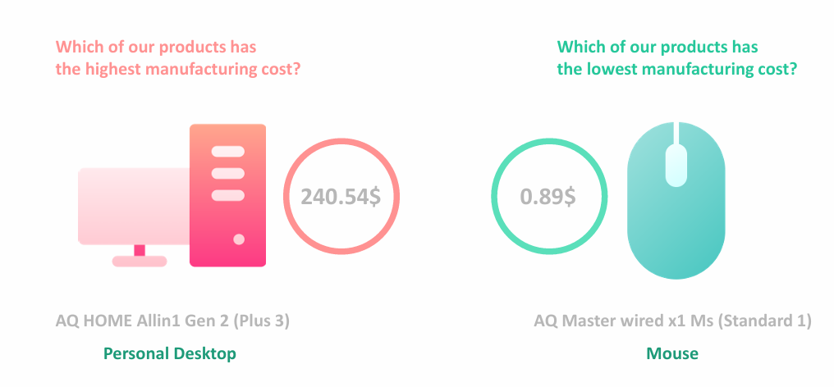
VISUAL REFFERENCE FOR REQUEST 05

Slide 18
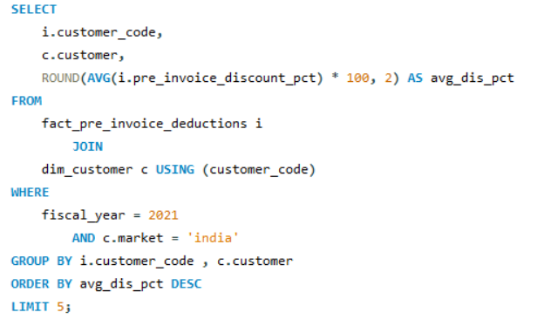
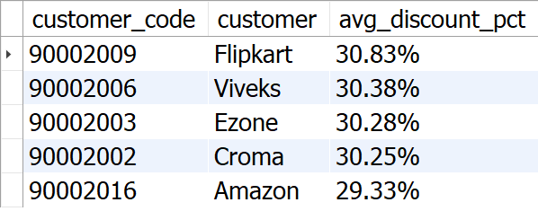
Request: 06
GENERATE A REPORT WHICH CONTAINS THE TOP 5 CUSTOMERS WHO RECEIVED AN AVERAGE HIGH PRE_INVOICE_DISCOUNT_PCT FOR THE FISCAL YEAR 2021 AND IN THE INDIAN MARKET. THE FINAL OUTPUT CONTAINS THESE FIELDS, CUSTOMER_CODE CUSTOMER AVERAGE_DISCOUNT_PERCENTAGE

Slide 19
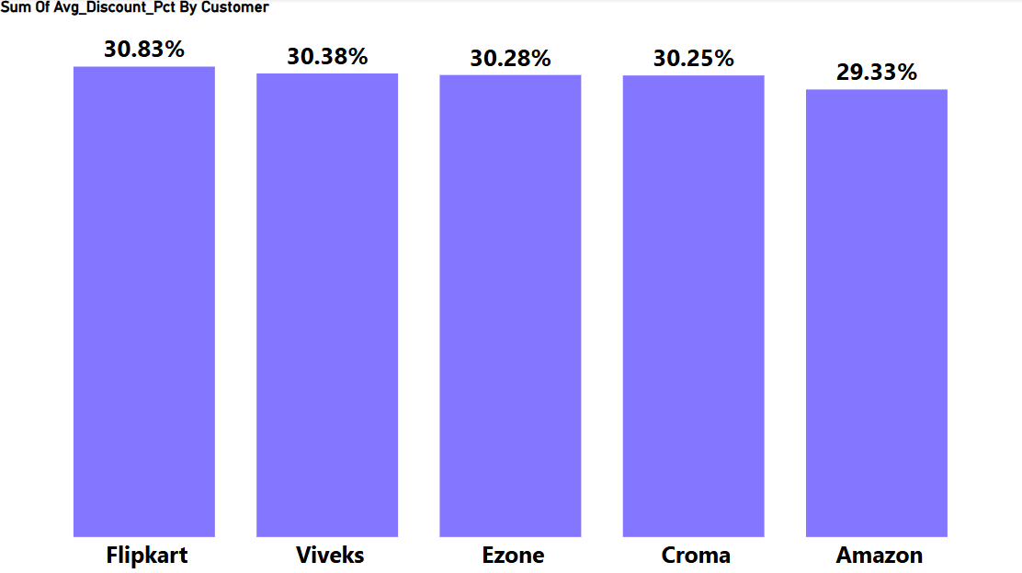
VISUAL REFFERENCE FOR REQUEST 06
INSIGHT:
1. Flipkart leads the list with the highest average discount percentage at 30.83%. 2. AtliQ has provided relatively uniform discount percentages to its top 5 customers, with a narrow range of discounts from 29.33% to 30.83%.

Slide 20
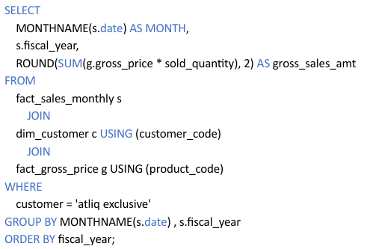
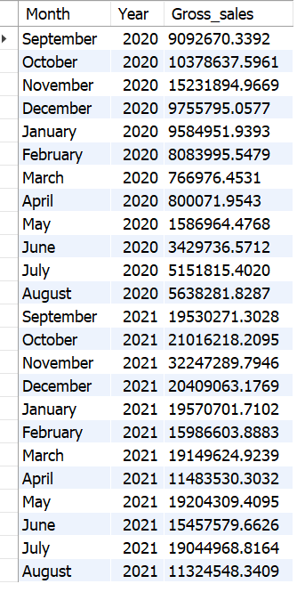
Request: 07
GET THE COMPLETE REPORT OF THE GROSS SALES AMOUNT FOR THE CUSTOMER “ATLIQ EXCLUSIVE” FOR EACH MONTH. THIS ANALYSIS HELPS TO GET AN IDEA OF LOW AND HIGH-PERFORMING MONTHS AND TAKE STRATEGIC DECISIONS. THE FINAL REPORT CONTAINS THESE COLUMNS: MONTH YEAR GROSS SALES AMOUNT

Slide 21
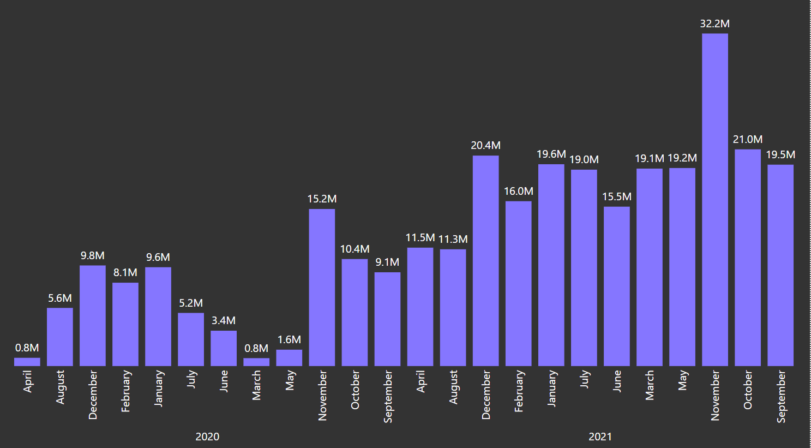
VISUAL REFFERENCE FOR REQUEST 07
1. March, April, May recorded the lowest sales in 2020, likely due to the COVID-19 pandemic. Sales began to recover after June 2020.
2. November generated the highest sales for 2020, with around 15.23 million.
3. Sales figures in 2021 show significant growth compared to 2020.
4. In 2021, the lowest sales were in August, accounting for 11.32 million, while the highest sales were in November, reaching 32.25 million.
INSIGHT:

Slide 22
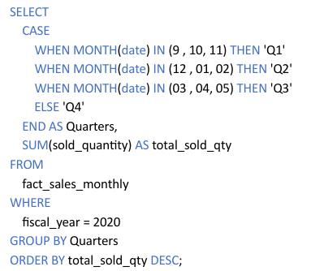
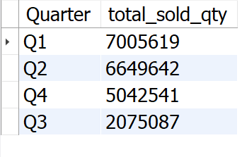
Request: 08
IN WHICH QUARTER OF 2020, GOT THE MAXIMUM TOTAL_SOLD_QUANTITY? THE FINAL OUTPUT CONTAINS THESE FIELDS SORTED BY THE TOTAL_SOLD_QUANTITY, QUARTER TOTAL_SOLD_QUANTITY

Slide 23
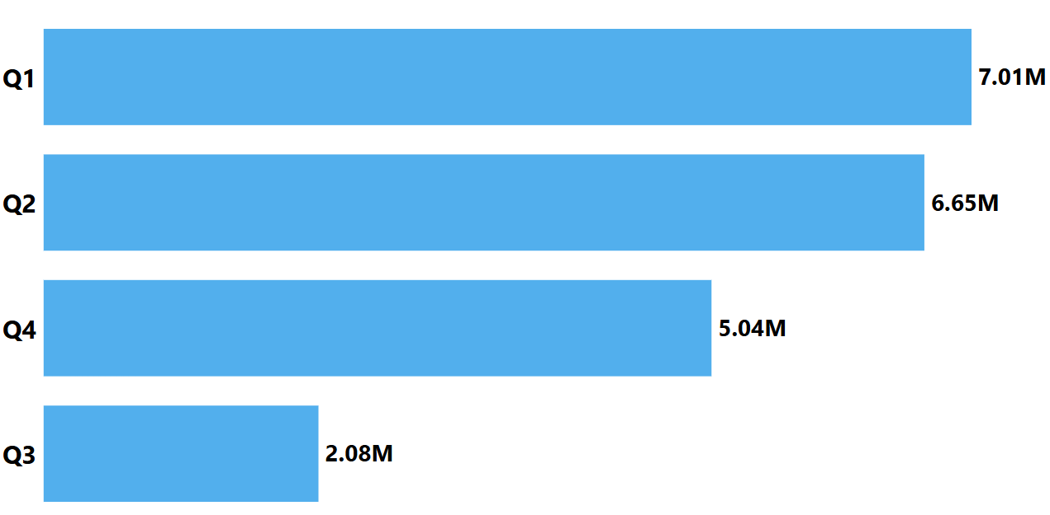
VISUAL REFFERENCE FOR REQUEST 08
1. Q1 (2020) saw the highest sales volume, reaching around 7 million units, indicating strong performance early in the year. 2. AtliQ experienced a significant decline in sales during Q3 (March, April, May), possibly due to the COVID-19 pandemic, reflecting challenging market conditions and shifting consumer behavior.
INSIGHT:

Slide 24
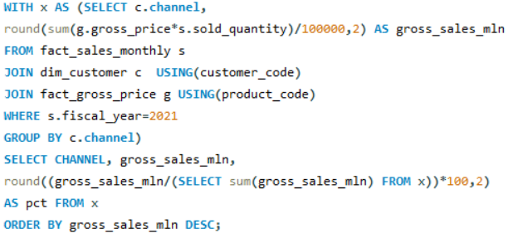
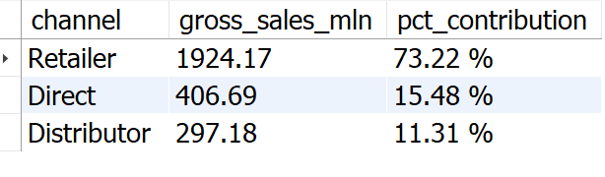
Request: 08
WHICH CHANNEL HELPED TO BRING MORE GROSS SALES IN THE FISCAL YEAR 2021 AND THE PERCENTAGE OF CONTRIBU ON? THE FINAL OUTPUT CONTAINS THESE FIELDS, CHANNEL GROSS_SALES_MLN PERCENTAGE

Slide 25
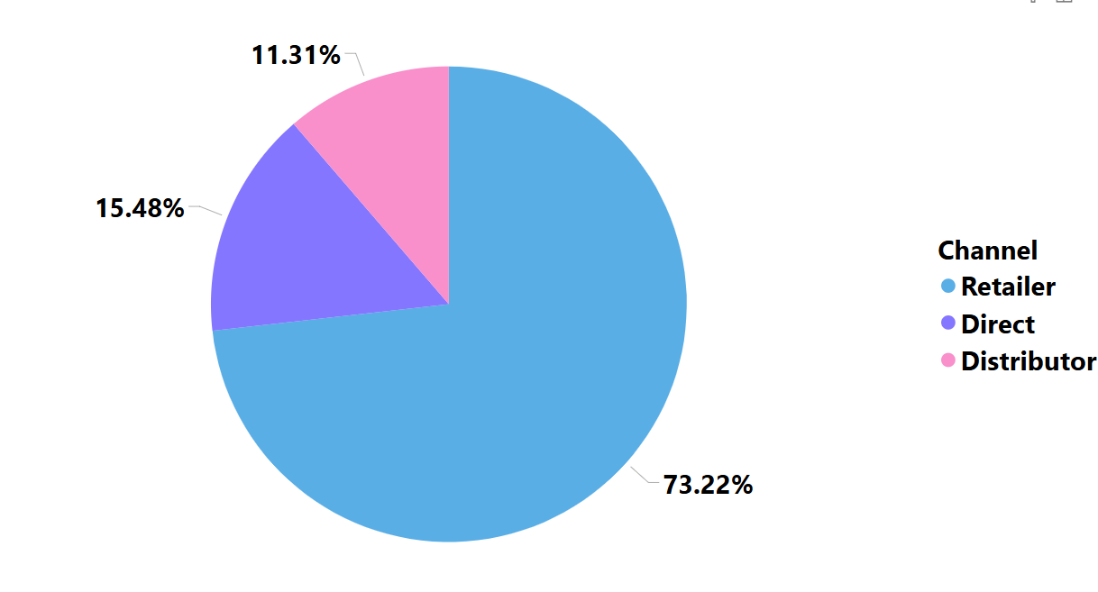
VISUAL REFFERENCE FOR REQUEST 09
INSIGHT:
1. The majority of AtliQ sales come from retailers, accounting for a substantial 73.22% of the total gross sales. 2. Direct and distributor channel together contributes only 26.79% of the total sales.

Slide 26
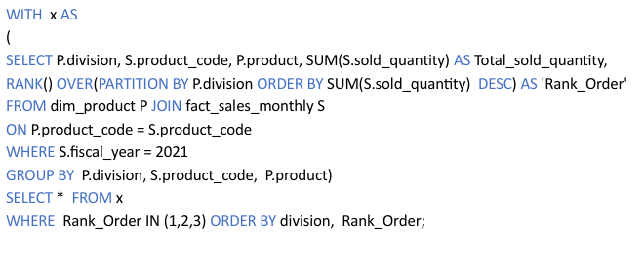
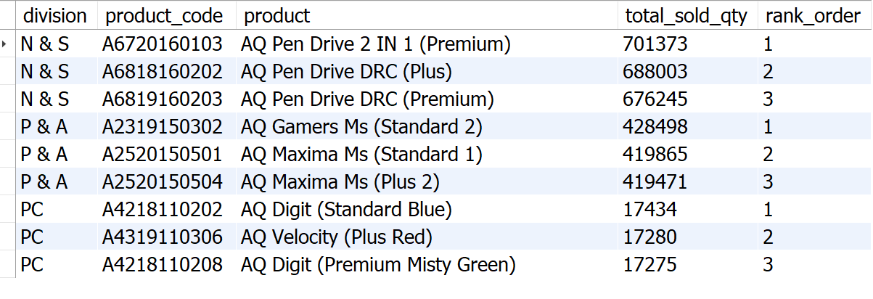
Request: 10
GET THE TOP 3 PRODUCTS IN EACH DIVISION THAT HAVE A HIGH TOTAL_SOLD_QUAN TY IN THE FISCAL_YEAR 2021? THE FINAL OUTPUT CONTAINS THESE FIELDS, DIVISION PRODUCT_CODE

Slide 27
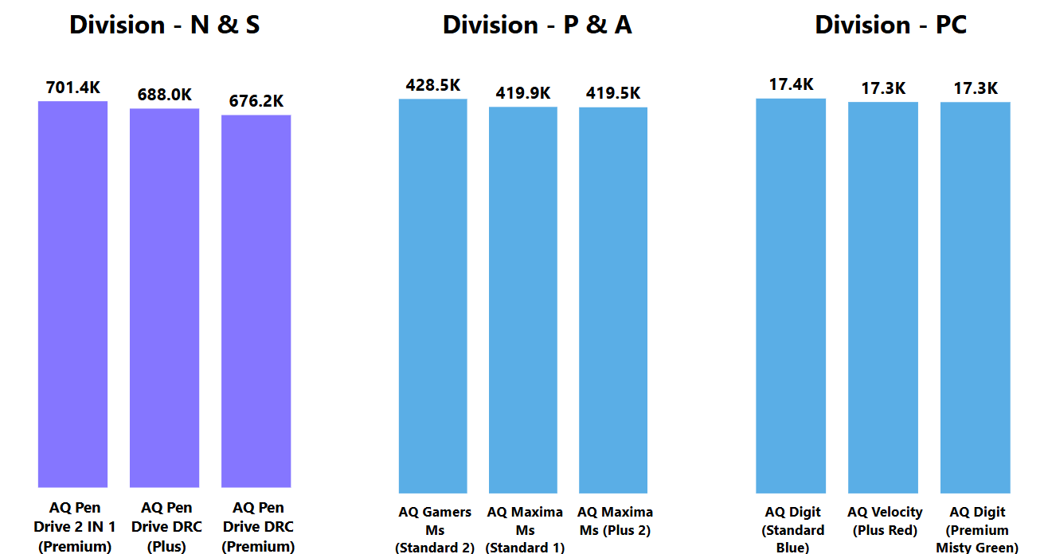
VISUAL REFFERENCE FOR REQUEST 10
1. In the N & S division, pen drives dominate the top three spots, showcasing their popularity and high sales performance. 2. The P & A division's top three products are exclusively mouse, reflecting a clear demand for these devices. 3. The PC division's bestsellers are all personal laptops.
INSIGHT:

Slide 28
Recommendations
1. Focus on desktops, Storage, and Networking segment. 2. Emphasizes multi-channel marketing. 3. Combine pricing strategies with attractive promotions. 4. Continuously improve based on customer feedback. 5. Invest in sales team training for improved performance.

Slide 29
THANK YOU

